Slide 1
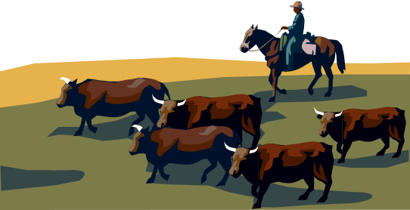
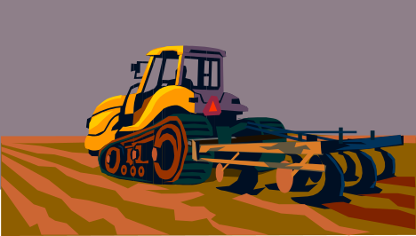
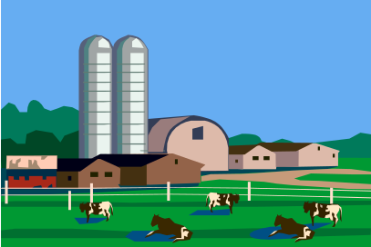
Introduction to Starting, Planning, and Operating a Farm Business
PART 1
Ralph M. Vaughn
Notes:
In 2006, nearly 650,000 businesses were started in the US.
More than 550,000 closed.
This class is intended to improve your chances for success in launching a new business enterprise.

Slide 2
Starting a Business
Business Planning Format
  Thought Process
  Structure
Unit = Business Plan Section
  SBA.gov
Practical Microbusiness Focus
Agriculture/Horticulture Examples
Introduction

Slide 3

Learning Objectives
Business Planning Process
What is a Value Proposition?
Company Description
Market Description & Assessment
Product/Service Description
Introduction

Slide 4
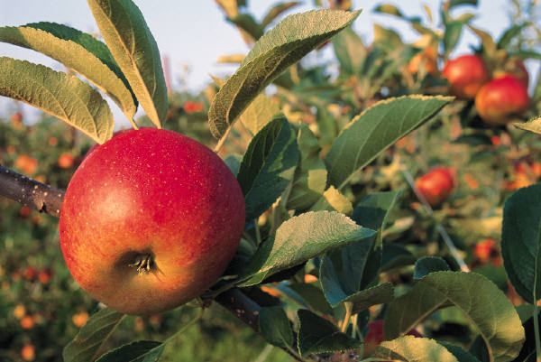
Business Planning

Slide 5
What is a Business Plan?
Detailed, written description of your business, business processes, customers, and your market
Living document – continuous process of assessing business viability
Guide to your business future
Introduction

Slide 6


Plans are a Reflection
Value is in the process of development
Shows you thought seriously
Reflects the character of you and your business
Introduction

Slide 7

Why Bother?
Prioritizes activity, exposes pitfalls, anticipates problems
Establishes goals and provides basis for performance comparison
Is my business feasible?
Builds your commitment to your business
Attracts others to your business
Provides a road map
Introduction

Slide 8

When do you need one?
May be Required for…
Bank financing
Investment partners
Strategic alliances
Large contracts
Key employees
Mergers and/or acquisitions
Credibility for Your Business!
Introduction
Notes:
This particular organization is based on developmental order.

Slide 9
Business Plan
Stakeholder | Emphasis
You | Business Feasibility
Banker | Cashflow
Investor | Growth
Strategic Partner | Business Synergy
Large Customer | Stability, Service
Key Employees | Opportunity
Introduction
Notes:
This particular organization is based on developmental order.

Slide 10

Business Plan
No single “right” format
Concise and focused
Accurate
Brutally honest
Includes negatives as well as positives
Obsolete soon as it’s printed!
Introduction
Notes:
This particular organization is based on developmental order.

Slide 11

Business Plan
10 Steps
Executive Summary
Value Proposition
Company Description
Market Description & Opportunity Assessment
Product/Service Description
Competitive Assessment
Marketing & Sales Strategy
Operations
Management and Employees
Financial Summary
Introduction
Notes:
This particular organization is based on developmental order.

Slide 12
Business Plan
10 Steps
Executive Summary
Value Proposition
Company Description
Market Description & Opportunity Assessment
Product/Service Description
Competitive Assessment
Marketing & Sales Strategy
Operations
Management and Employees
Financial Summary
Introduction
Notes:
This particular organization is based on developmental order.

Slide 13
Value Proposition
Your business idea in a nutshell
A clear statement of the tangible value/results your customers get from using your products/services
Answers why your business will succeed
Specific and compelling
Introduction
Notes:
30 second elevator speech to a stranger.
Grandmother should be able to understand the value proposition.

Slide 14
Mission Statement
A Short and Simple Statement
  Outlines an Organizations Purpose
Composed of Three Components:
  Key Market
    Target Client or Customer
  Contribution
    What Product/Service is Provided
  Distinction
    Uniqueness of Product/Service
Introduction
Notes:
30 second elevator speech to a stranger.
Grandmother should be able to understand the value proposition.

Slide 15

Value Proposition
WEAK – “We sell apple trees.”
STRONG – “We offer high vigor hybrid apple trees that yield 5% more than standard varieties to the retail market place.”
Introduction
Notes:
30 second elevator speech to a stranger.
Grandmother should be able to understand the value proposition.

Slide 16

Value Proposition
Example – Can you Guess?
“We provide a friendly, comfortable, well-located place offering a wide range of fresh, customized quality coffees, teas, and other beverages for the person who enjoys a good experience and a good beverage.”
Introduction
Notes:
30 second elevator speech to a stranger.
Grandmother should be able to understand the value proposition.

Slide 17
Your Value Proposition Contains:
What (your product or service)
  Sell Apple Trees
To Whom (your customer)
  Retail Market
Why (your competitive advantage)
  Five Percent Better Yield
Introduction
Notes:
30 second elevator speech to a stranger.
Grandmother should be able to understand the value proposition.

Slide 18




Value Proposition
Dimensions of Value
Innovative Offering
A better mousetrap
Features
Performance
Packaging
Introduction

Slide 19



Value Proposition
Dimensions of Value
Lower Cost
The same, for less
Introduction

Slide 20



Value Proposition
Dimensions of Value
Quality, Reliability
Best quality
Introduction

Slide 21



Value Proposition
Dimensions of Value
Customer Responsiveness
Customer is #1
Introduction

Slide 22

Value Proposition
Dimensions of Value
Unique Niche
  Location
  Customer Knowledge
  Specialized Know-How
Local is Better
Introduction

Slide 23

Value Proposition
Now Write Yours…
What (your product or service)
To Whom (your customer)
Why (your competitive advantage)
Introduction
Notes:
30 second elevator speech to a stranger.
Grandmother should be able to understand the value proposition.

Slide 24
REVIEW AND DISCUSS YOUR VALUE PROPOSITION
Introduction
Notes:
30 second elevator speech to a stranger.
Grandmother should be able to understand the value proposition.

